Slide 1
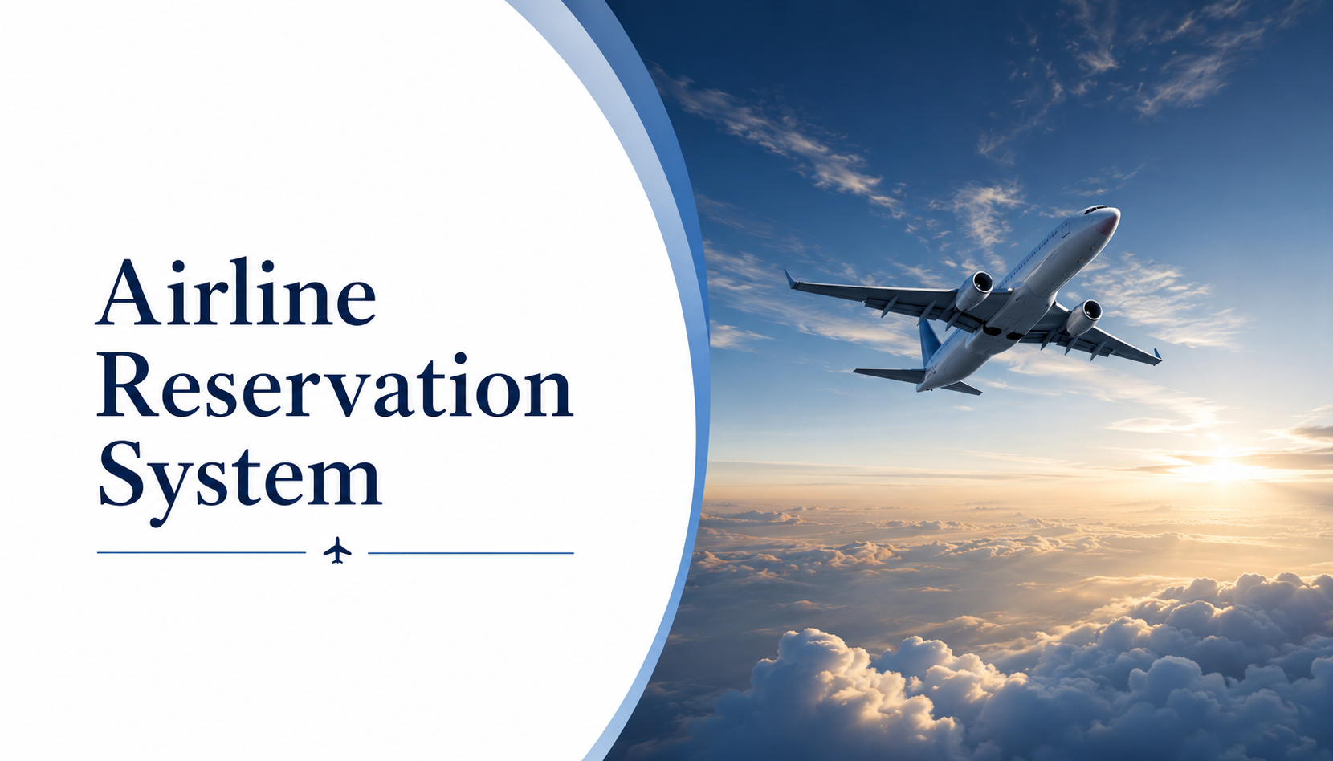

Slide 2
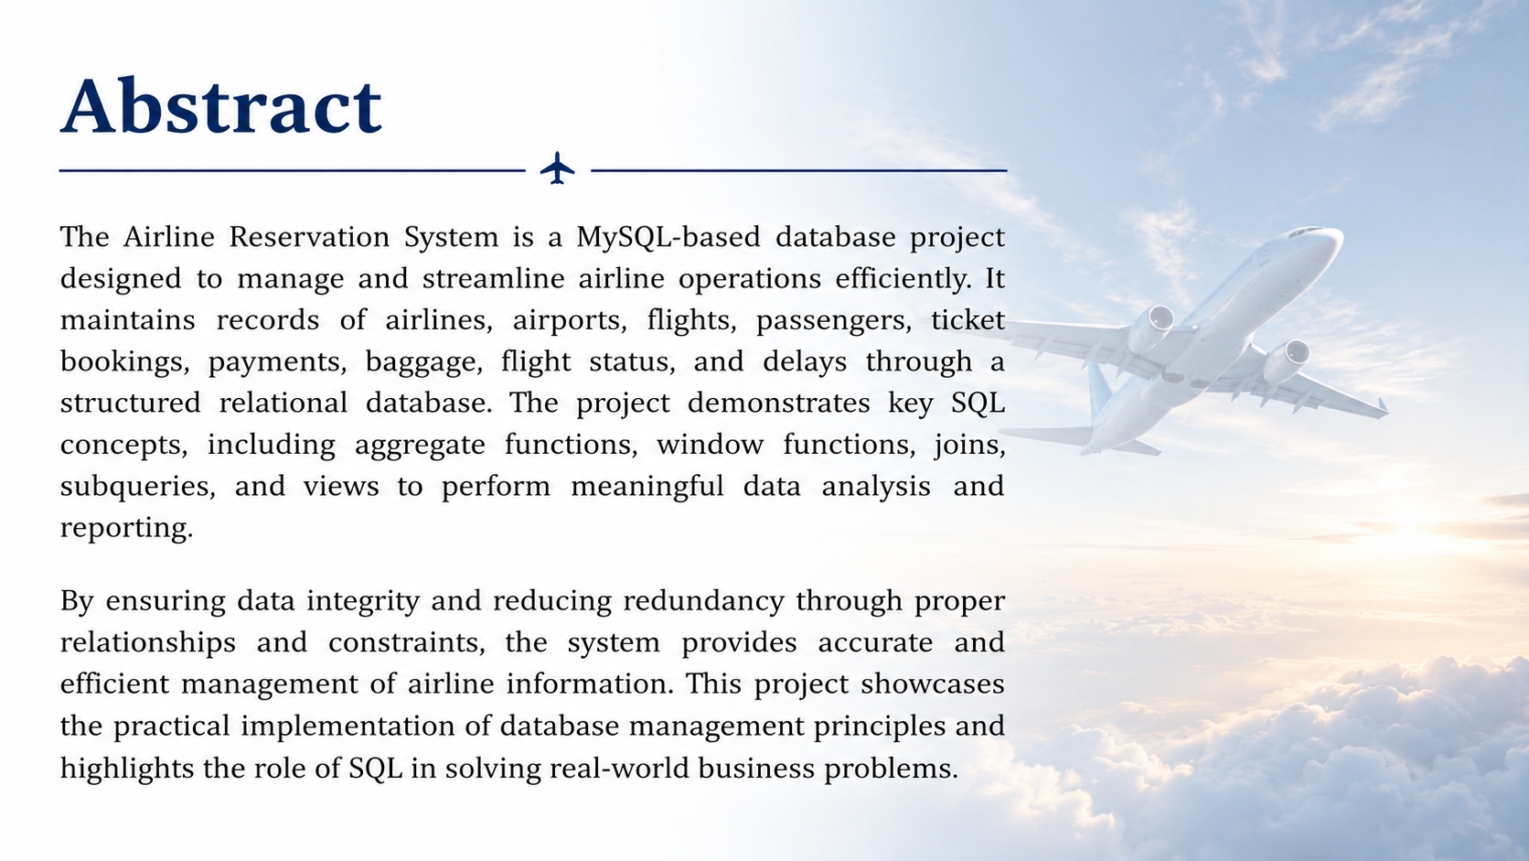

Slide 3
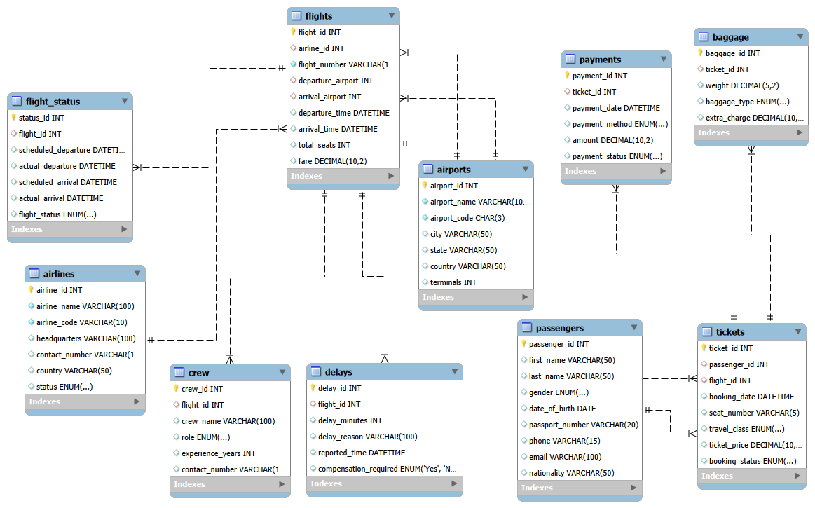
ER-Diagram

Slide 4

Structure of Table

Slide 5
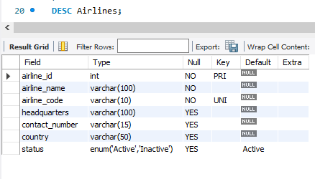
Table 1: Airlines
Airlines Table
This table stores information about different airlines operating flights in the system. It contains details such as airline identification, airline name, country, and contact information. The table helps maintain airline-related records and establishes a relationship with the Flights table for managing flight operations.
SYNTAX:- DESC Airlines;

Slide 6
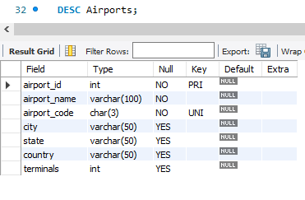
Table 2: Airports
Airports Table
This table stores information about different airports involved in flight operations. It contains details such as airport identification, airport name, city, country, and airport code. The table helps manage departure and arrival locations of flights and maintains airport-related records within the airline reservation system.
SYNTAX:- DESC Airports;

Slide 7
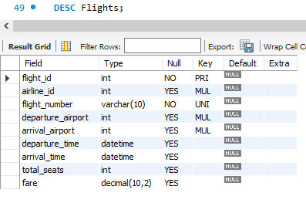
Table 3: Flights
Flights Table
This table stores information about all flights available in the airline reservation system. It contains details such as flight identification, flight number, airline information, departure and arrival locations, travel dates, and flight timing. The table helps manage flight schedules and establishes relationships between airlines, airports, and ticket bookings.
SYNTAX:- DESC Flights;

Slide 8
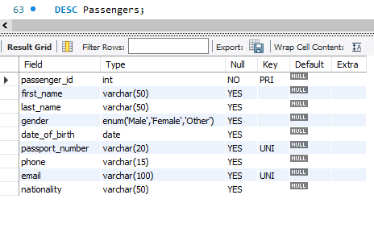
Table 4: Passengers
Passengers Table
This table stores information about passengers who use the airline reservation system. It contains personal details of passengers such as their identification number, name, contact information, and other relevant details required for ticket booking and travel management. The table helps maintain passenger records and establishes a relationship with ticket bookings.
SYNTAX:- DESC Passengers;

Slide 9
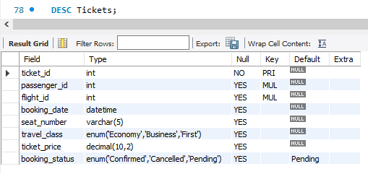
Table 5: Tickets
Tickets Table
This table stores information about flight ticket bookings made by passengers in the airline reservation system. It contains details such as ticket identification, passenger details, flight details, seat information, travel class, booking date, and booking status. The table helps manage passenger reservations and maintains the connection between passengers and flights.
SYNTAX:- DESC Tickets;

Slide 10
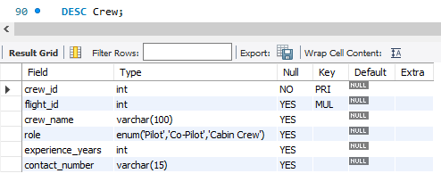
Table 6: Crew
Crew Table
This table stores information about the crew members assigned to flights in the airline reservation system. It contains details such as crew identification, name, role, contact information, and assigned flight details. The table helps manage airline staff records and maintains information about crew members responsible for flight operations.
SYNTAX:- DESC Crew;

Slide 11
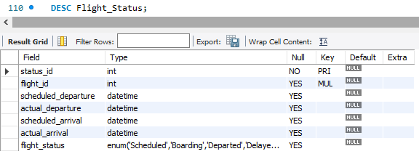
Table 7: Fight_Status
Flight_Status Table
This table stores the current and historical status information of flights in the airline reservation system. It contains details such as flight status identification, flight reference, status type, update time, and additional remarks. The table helps track flight operations and provides real-time information about scheduled, delayed, cancelled, or completed flights.
SYNTAX:- DESC Flight_Status;

Slide 12
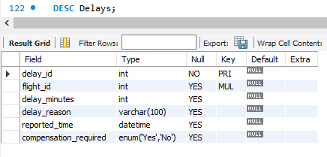
Table 8: Delays
Delays Table
This table stores information about flight delays in the airline reservation system. It contains details such as the delayed flight, delay duration, reason for the delay, and the date of the delay. The table helps monitor flight performance, analyze operational issues, and generate reports on flight delays for better decision-making.
SYNTAX:- DESC Delays;

Slide 13
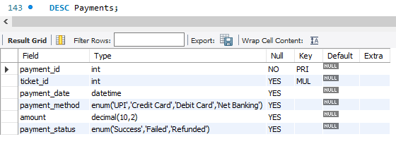
Table 9: Payments
Payments Table
This table stores information about payment transactions made for ticket bookings in the airline reservation system. It contains details such as payment identification, ticket reference, payment method, amount paid, payment date, and payment status. The table helps manage payment records, track successful and pending transactions, and ensure accurate financial reporting.
SYNTAX:- DESC Payments;

Slide 14
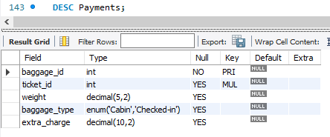
Table 10: Baggage
Baggage Table
This table stores information about the baggage associated with passenger tickets in the airline reservation system. It contains details such as baggage identification, ticket reference, baggage weight, baggage type, and baggage status. The table helps manage passenger luggage, monitor baggage handling, and ensure smooth tracking throughout the travel process.
SYNTAX:- DESC Baggage;

Slide 15
Contents of Table

Slide 16
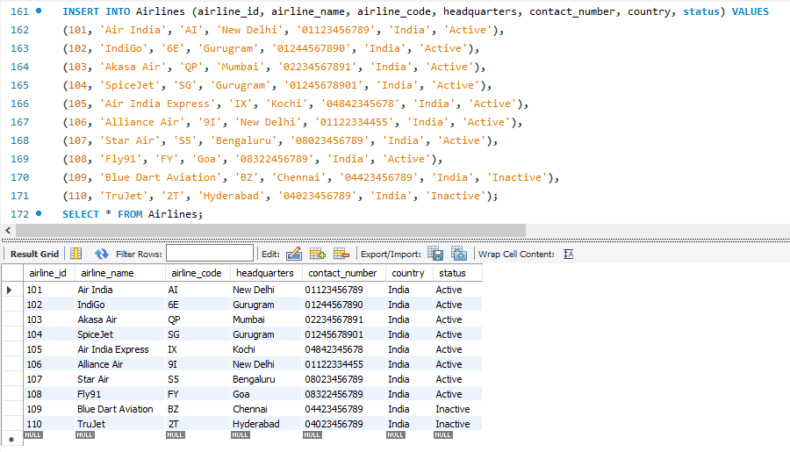
Table 1: Airlines
Displays all airline records stored in the database, including their codes, headquarters, and operational status.

Slide 17
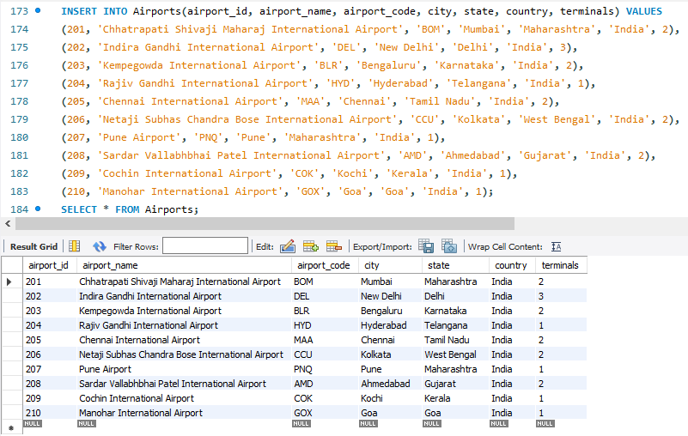
Table 2: Airports
Displays details of all airports, including airport codes, cities, and countries.

Slide 18
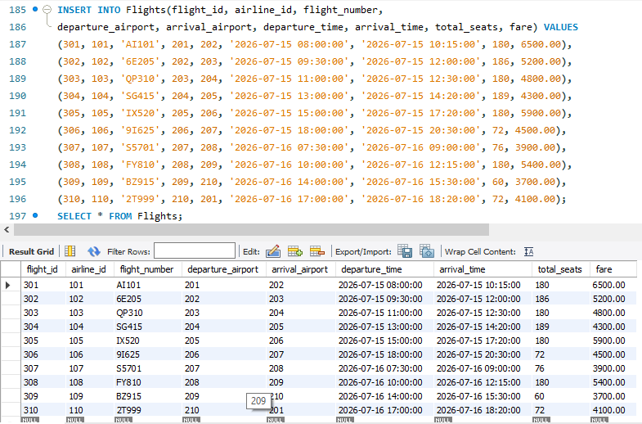
Table 3: Flights
Displays flight schedules, routes, timings, and current flight status.

Slide 19
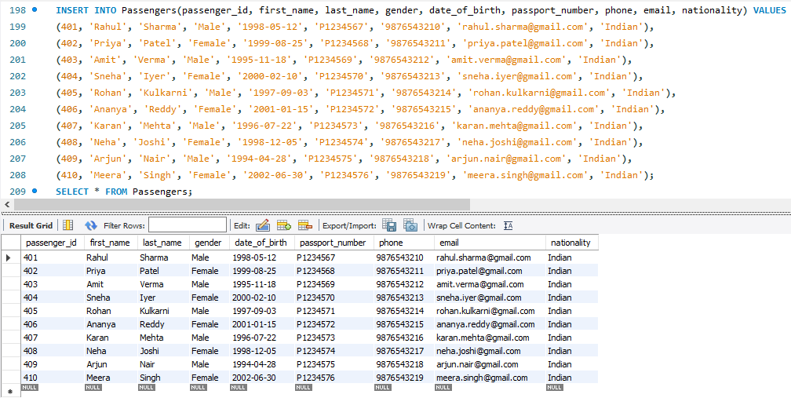
Table 4: Passengers
Displays passenger information such as personal details and contact information.

Slide 20
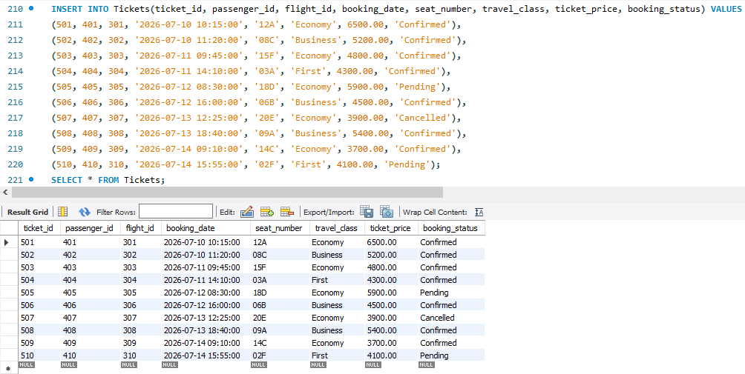
Table 5: Tickets
Displays ticket booking details, including passenger, flight, seat, and booking status.

Slide 21
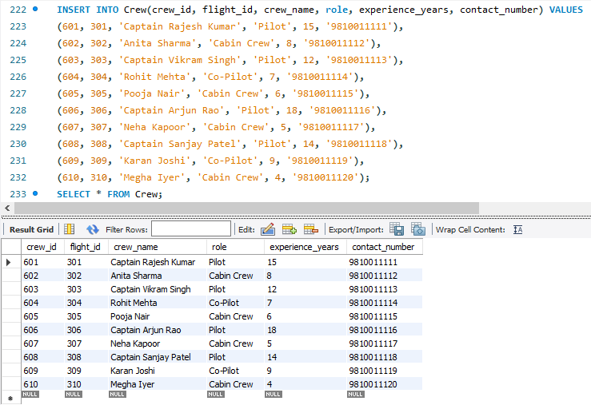
Table 6: Crew
Displays details of crew members assigned to different flights and their roles.

Slide 22
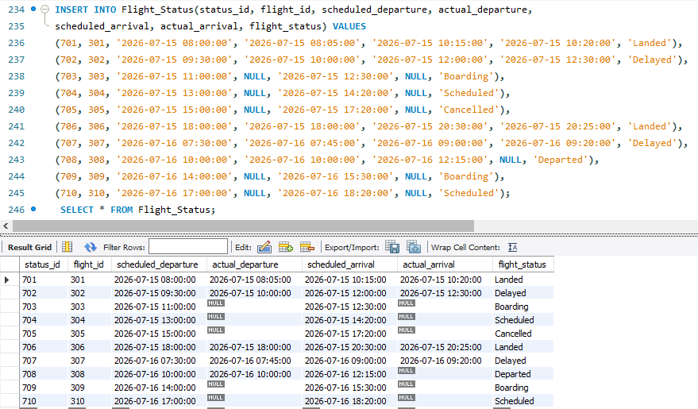
Table 7: Fight_Status
Displays the current status of flights, such as Scheduled, Delayed, or Cancelled.

Slide 23
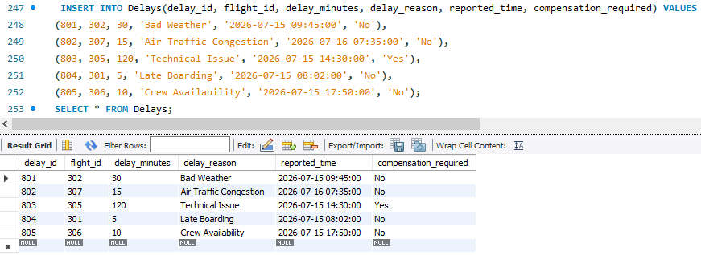
Table 8: Delays
Displays records of delayed flights along with delay duration and reasons.

Slide 24
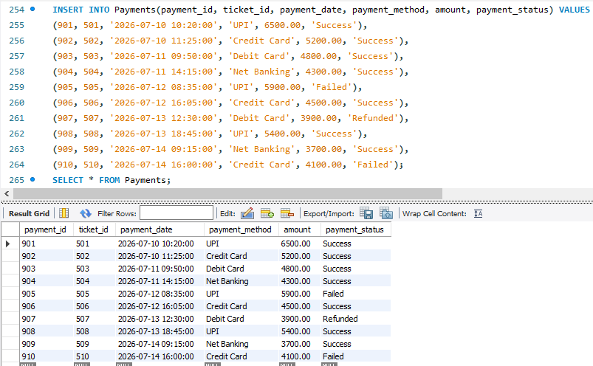
Table 9: Payments
Displays payment details for ticket bookings, including amount, method, and payment status.

Slide 25
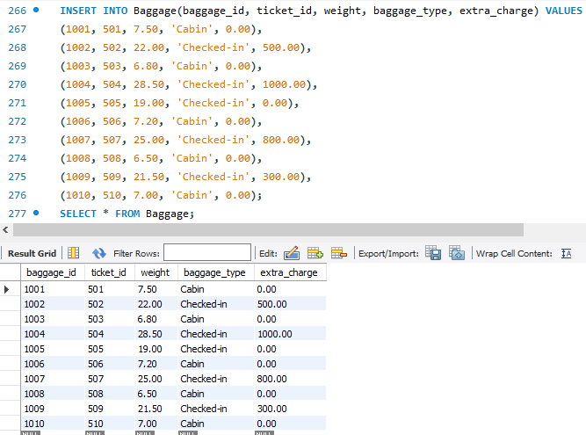
Table 10: Baggage
Displays baggage information associated with passenger tickets, including weight, type, and status.

Slide 26
Basic Queries

Slide 27
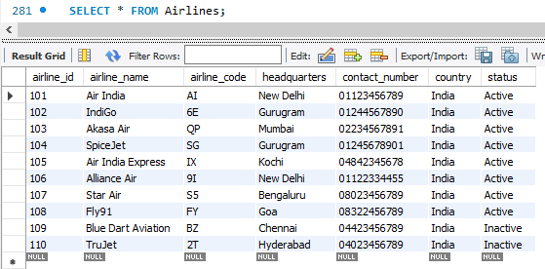
SELECT CLAUSE
QUERY:- Display all airline details.
SYNTAX:- SELECT * FROM Airlines;

Slide 28
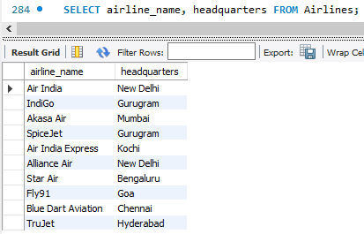
SELECT CLAUSE
QUERY:- Display the airline name and headquarters.
SYNTAX:- SELECT airline_name, headquarters FROM Airlines;

Slide 29
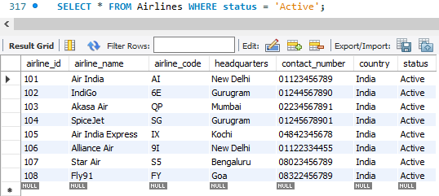
WHERE CLAUSE
QUERY:- Show all active airlines.
SYNTAX:- SELECT * FROM Airlines WHERE status = 'Active';

Slide 30
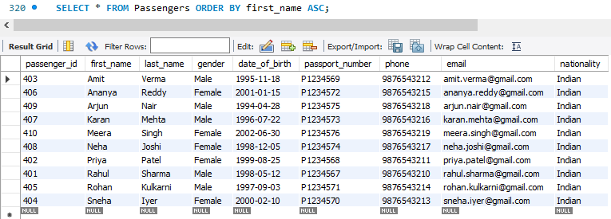
ORDER BY CLAUSE
QUERY:- Display passengers sorted by first name.
SYNTAX:- SELECT * FROM Passengers ORDER BY first_name ASC;

Slide 31
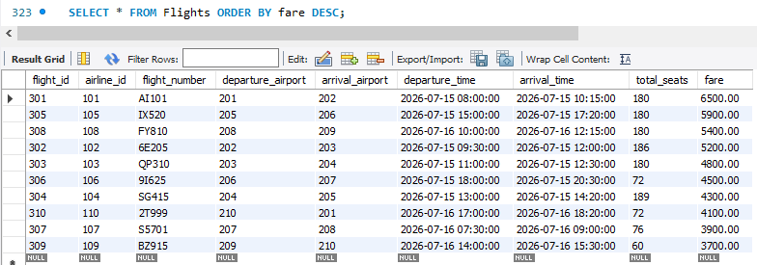
ORDER BY CLAUSE
QUERY:- Show flights with the highest fare first.
SYNTAX:- SELECT * FROM Flights ORDER BY fare DESC;

Slide 32
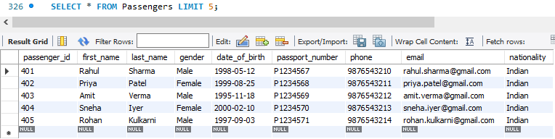
LIMIT CLAUSE
QUERY:- Show the first 5 passengers.
SYNTAX:- SELECT * FROM Passengers LIMIT 5;

Slide 33
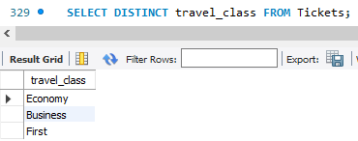
DISTINCT CLAUSE
QUERY:- Show all unique travel classes.
SYNTAX:- SELECT DISTINCT travel_class FROM Tickets;

Slide 34
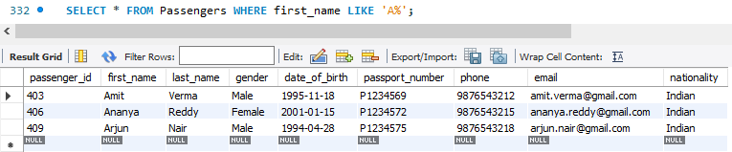
LIKE CLAUSE
QUERY:- Find passengers whose first name starts with 'A'.
SYNTAX:- SELECT * FROM Passengers WHERE first_name LIKE 'A%';

Slide 35
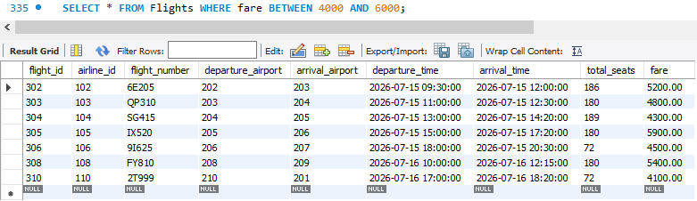
BETWEEN CLAUSE
QUERY:- Show flights with fares between ₹4000 and ₹6000.
SYNTAX:- SELECT * FROM Flights WHERE fare BETWEEN 4000 AND 6000;

Slide 36
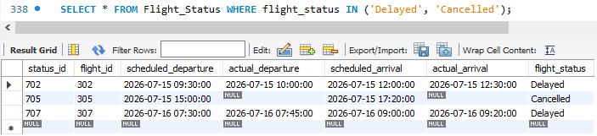
IN CLAUSE
QUERY:- Show flights that are delayed and cancelled.
SYNTAX:- SELECT * FROM Flight_Status WHERE flight_status IN ('Delayed', 'Cancelled');

Slide 37
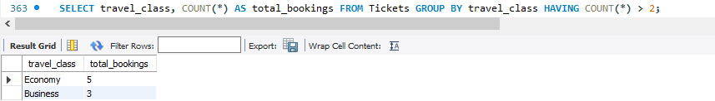
HAVING CLAUSE
QUERY:- Show travel classes with more than 2 bookings.
SYNTAX:- SELECT travel_class, COUNT(*) AS total_bookings FROM Tickets GROUP BY travel_class HAVING COUNT(*) > 2;

Slide 38
Aggregate Functions

Slide 39
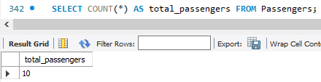
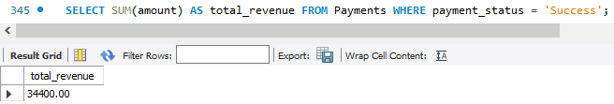
COUNT & SUM FUNCTION
QUERY:- How many passengers are there?
SYNTAX:- SELECT COUNT(*) AS total_passengers FROM Passengers;
QUERY:- Calculate the total revenue from successful payments.
SELECT SUM(amount) AS total_revenue FROM Payments WHERE payment_status = 'Success';

Slide 40
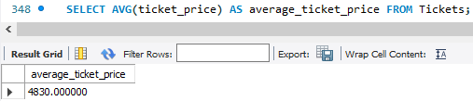
AVERAGE FUNCTION
QUERY:- Find the average ticket price.
SYNTAX:- SELECT AVG(ticket_price) AS average_ticket_price FROM Tickets;
Calculates the average value of a numeric column by dividing the total sum by the number of records.(Ignores null values)

Slide 41
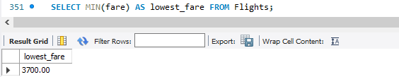
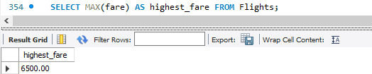
MIN & MAX FUNCTION
QUERY:- Find the cheapest flight.
SELECT MIN(fare) AS lowest_fare FROM Flights;
QUERY:- Find the most expensive flight.
SELECT MAX(fare) AS highest_fare FROM Flights;

Slide 42
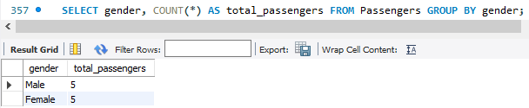
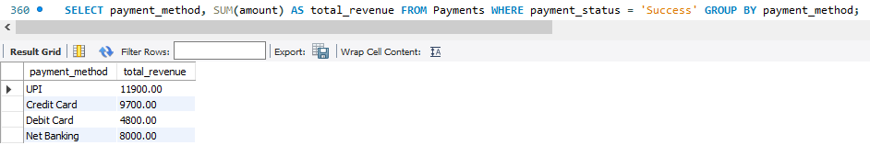
FUNCTIONS WITH CLAUSES
QUERY:- Count passengers by gender.
SYNTAX:- SELECT gender, COUNT(*) AS total_passengers FROM Passengers GROUP BY gender;
QUERY:- Find revenue by payment method.
SYNTAX:- SELECT payment_method, SUM(amount) AS total_revenue FROM Payments WHERE payment_status = 'Success' GROUP BY payment_method;

Slide 43
Window Functions

Slide 44
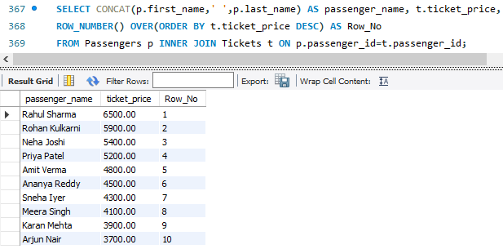
ROW_NUMBER
QUERY:- Assign a unique rank to passengers based on ticket price.
SYNTAX:- SELECT CONCAT(p.first_name,' ',p.last_name) AS passenger_name, t.ticket_price, ROW_NUMBER() OVER(ORDER BY t.ticket_price DESC) AS Row_No
FROM Passengers p INNER JOIN Tickets t ON p.passenger_id=t.passenger_id;

Slide 45
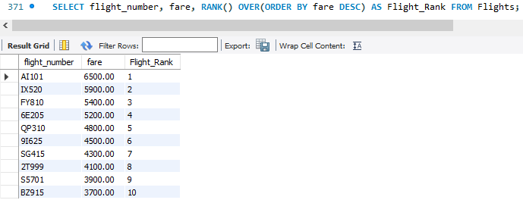
RANK
QUERY:- Rank flights according to fare.
SNTAX:- SELECT flight_number, fare, RANK() OVER(ORDER BY fare DESC) AS Flight_Rank FROM Flights;

Slide 46
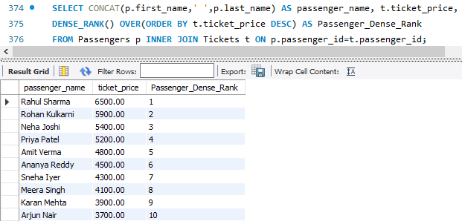
DENSE_RANK
QUERY:- Rank passengers according to ticket price.
SYNTAX:- SELECT CONCAT(p.first_name,' ',p.last_name) AS passenger_name, t.ticket_price,
DENSE_RANK() OVER(ORDER BY t.ticket_price DESC) AS Passenger_Dense_Rank
FROM Passengers p INNER JOIN Tickets t ON p.passenger_id=t.passenger_id;

Slide 47
Joins

Slide 48
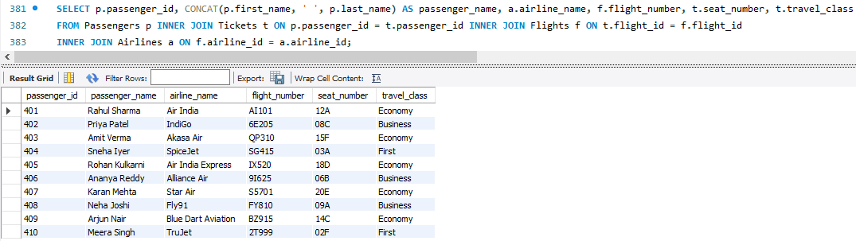
INNER JOIN
QUERY:- Display passenger booking details with airline and flight information.
SYNTAX:- SELECT p.passenger_id, CONCAT(p.first_name, ' ', p.last_name) AS passenger_name, a.airline_name, f.flight_number, t.seat_number, t.travel_class FROM Passengers p INNER JOIN Tickets t ON p.passenger_id = t.passenger_id INNER JOIN Flights f ON t.flight_id = f.flight_id INNER JOIN Airlines a ON f.airline_id = a.airline_id;

Slide 49
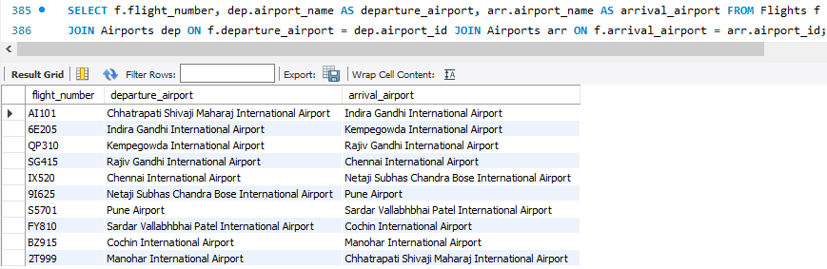
JOIN
QUERY:- Show departure and arrival airports for every flight.
SYNTAX:- SELECT f.flight_number, dep.airport_name AS departure_airport, arr.airport_name AS arrival_airport FROM Flights f JOIN Airports dep ON f.departure_airport = dep.airport_id JOIN Airports arr ON f.arrival_airport = arr.airport_id;

Slide 50
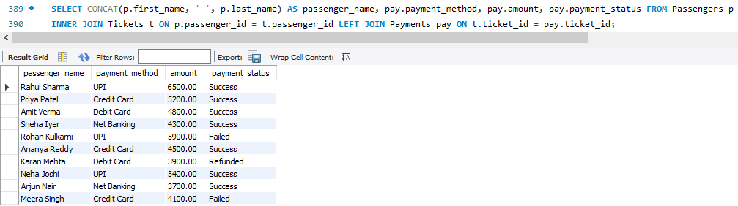
LEFT JOIN
QUERY:- Display payment details of each passenger.
SYNTAX:- SELECT CONCAT(p.first_name, ' ', p.last_name) AS passenger_name, pay.payment_method, pay.amount, pay.payment_status FROM Passengers p INNER JOIN Tickets t ON p.passenger_id = t.passenger_id LEFT JOIN Payments pay ON t.ticket_id = pay.ticket_id;

Slide 51
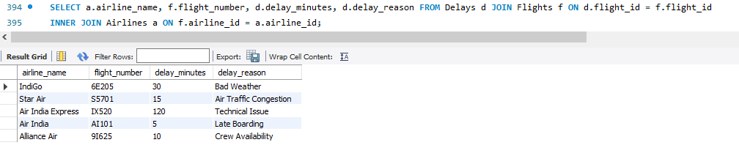
JOIN
QUERY:- Display delayed flights with airline name and delay reason.
SYNTAX:- SELECT a.airline_name, f.flight_number, d.delay_minutes, d.delay_reason
FROM Delays d JOIN Flights f ON d.flight_id = f.flight_id INNER JOIN Airlines a ON f.airline_id = a.airline_id;

Slide 52
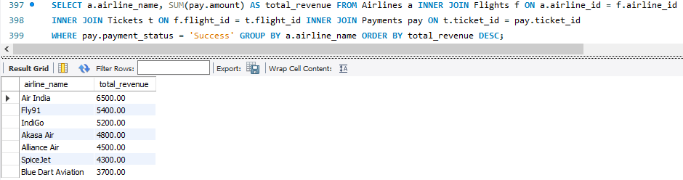
INNER JOIN + GROUP BY
QUERY:- Which airline earned the highest revenue?
SYNTAX:- SELECT a.airline_name, SUM(pay.amount) AS total_revenue FROM Airlines a INNER JOIN Flights f ON a.airline_id = f.airline_id INNER JOIN Tickets t ON f.flight_id = t.flight_id INNER JOIN Payments pay ON t.ticket_id = pay.ticket_id WHERE pay.payment_status = 'Success' GROUP BY a.airline_name ORDER BY total_revenue DESC;

Slide 53
Subqueries

Slide 54
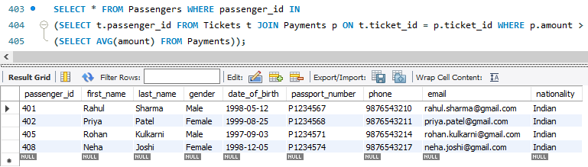
SUBQUERY 1
QUERY:- Find passengers who paid more than the average payment amount.
SYNTAX:- SELECT * FROM Passengers WHERE passenger_id IN
(SELECT t.passenger_id FROM Tickets t JOIN Payments p ON t.ticket_id = p.ticket_id WHERE p.amount > (SELECT AVG(amount) FROM Payments));

Slide 55


SUBQUERY 2 & SUBQUERY 3
QUERY:- Find the flight with the highest fare.
SYNTAX:- SELECT * FROM Flights WHERE fare = (SELECT MAX(fare) FROM Flights);
QUERY:- Which airline has the highest-priced flight?
SYNTAX:-SELECT airline_name FROM Airlines WHERE airline_id =
(SELECT airline_id FROM Flights WHERE fare = (SELECT MAX(fare) FROM Flights));

Slide 56

SUBQUERY 4
QUERY:- Find passengers who paid more than the average payment amount.
SYNTAX:- SELECT * FROM Passengers WHERE passenger_id IN
(SELECT t.passenger_id FROM Tickets t JOIN Payments p ON t.ticket_id = p.ticket_id WHERE p.amount > (SELECT AVG(amount) FROM Payments));

Slide 57

SUBQUERY 5
QUERY:- Find passengers whose ticket price is greater than the average ticket price.
SYNTAX:- SELECT CONCAT(p.first_name," ",p.last_name) as passenger_name, t.ticket_price FROM Passengers p JOIN Tickets t ON p.passenger_id = t.passenger_id WHERE t.ticket_price > (SELECT AVG(ticket_price) FROM Tickets);

Slide 58
Views

Slide 59

VIEW 1
QUERY:- Create a view to display complete passenger booking details.
SYNTAX:- CREATE VIEW Passenger_Booking_Details AS
SELECT CONCAT(p.first_name, ' ', p.last_name) AS passenger_name, a.airline_name, f.flight_number, t.travel_class, t.booking_status FROM Passengers p INNER JOIN Tickets t ON p.passenger_id = t.passenger_id INNER JOIN Flights f ON t.flight_id = f.flight_id INNER JOIN Airlines a ON f.airline_id = a.airline_id;
SELECT * FROM Passenger_Booking_Details;

Slide 60

VIEW 2
QUERY:- Create a view to display the total successful revenue generated by each airline.
SYNTAX:- CREATE VIEW Airline_Revenue_Report AS
SELECT a.airline_name, SUM(pay.amount) AS total_revenue FROM Airlines a INNER JOIN Flights f ON a.airline_id = f.airline_id INNER JOIN Tickets t ON f.flight_id = t.flight_id INNER JOIN Payments pay ON t.ticket_id = pay.ticket_id WHERE pay.payment_status = 'Success' GROUP BY a.airline_name;
SELECT * FROM Airline_Revenue_Report;

Slide 61

VIEW 3
QUERY:- Create a view to display delayed flights with airline name and delay reason.
SYNTAX:- CREATE VIEW Flight_Delay_Report AS
SELECT a.airline_name, f.flight_number, d.delay_minutes, d.delay_reason FROM Delays d
INNER JOIN Flights f ON d.flight_id = f.flight_id
INNER JOIN Airlines a ON f.airline_id = a.airline_id;
SELECT * FROM Flight_Delay_Report;

Slide 62


Slide 63

THANK YOU!

